Slide 1
Distributed GATK
Mark DePristo
January 26, 2011
Manager, Medical and Population Genetics Analysis
Broad Institute of MIT and Harvard

Slide 2
Data and definitions
CEU Trio HiSeq exomes
Details analysis of 32 distributed jobs
Hour queue
FIN data set: chr20, ~70 samples low-pass
Scaling relative to scatter-gather
Not final implementation
Uses Lucene file locking via creation
Still some edge case failure modes
Not yet fully optimized

Slide 3
CEU trio distributed parallelism

Slide 4
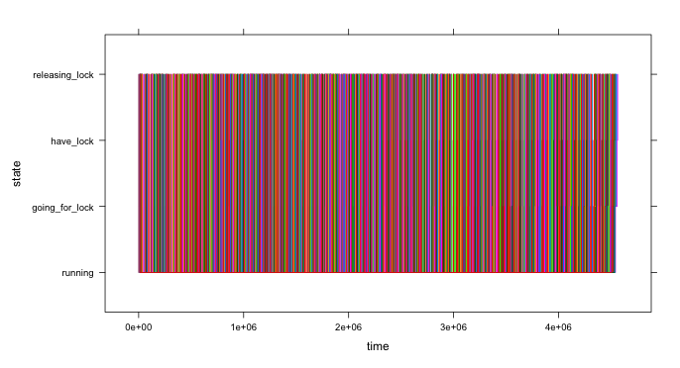
Distributed processes interlace their processing over time
Each line is a different process, changing state

Slide 5
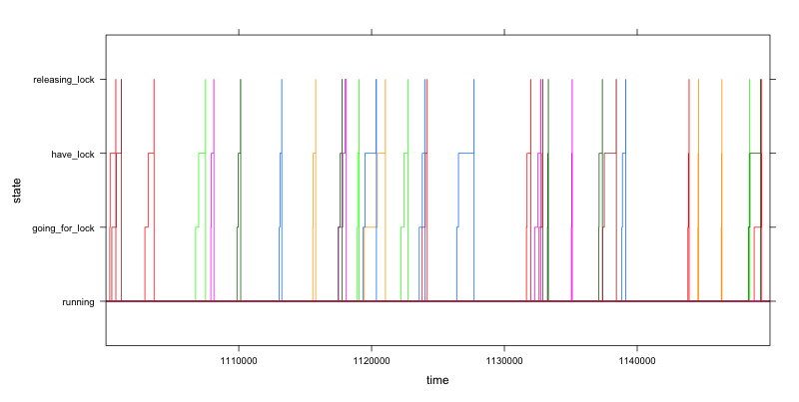
Close up of interprocess communcation

Slide 6
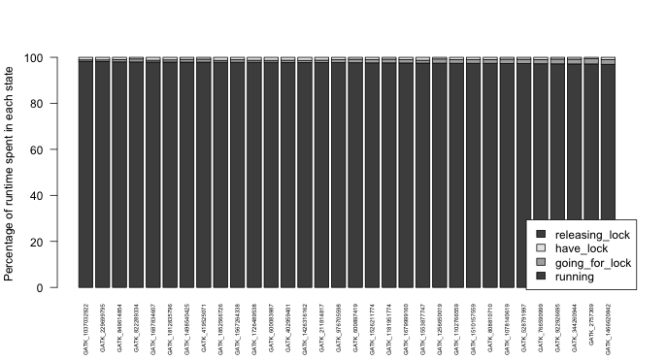
Most runtime is spent running, not on inter-process synchronization

Slide 7
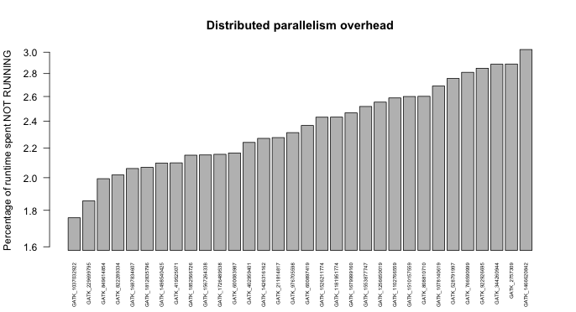
Distributed parallelize has little overhead (<5%)

Slide 8
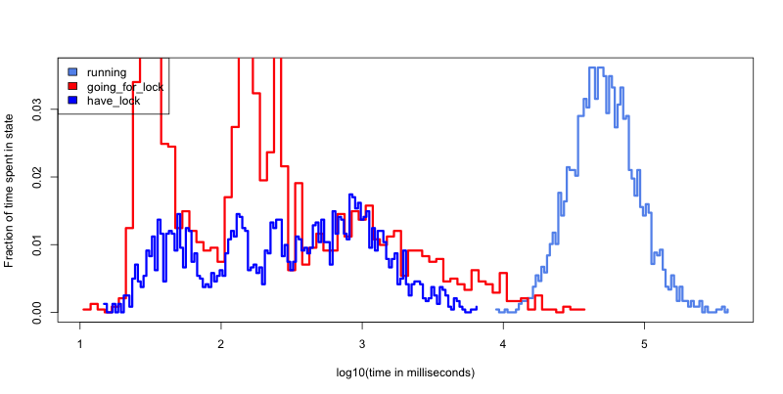
Histogram of job status

Slide 9
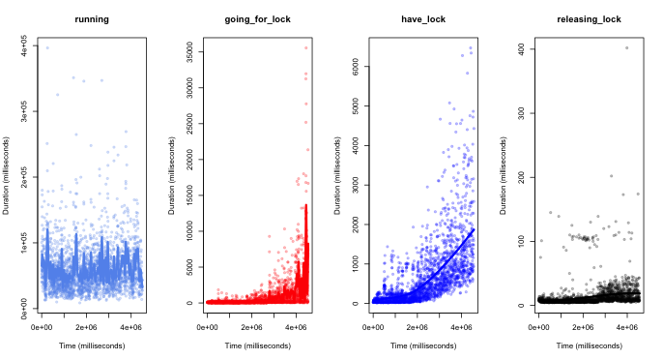
Overhead increases with increasing intervals processed (to fix)

Slide 10
FIN distributed parallelism

Slide 11
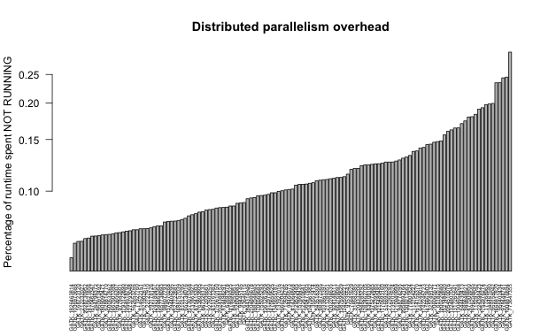
128 ways parallel FINs: ~0.1% overhead

Slide 12
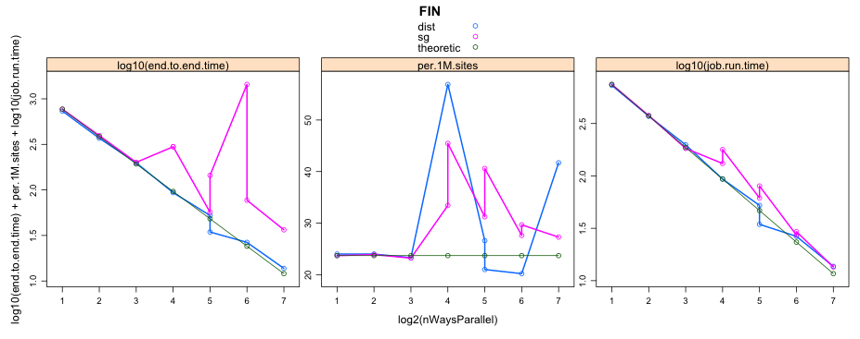
Scatter-gather vs. distributed parallelism: FIN
10x longer end-to-end due to week queue scheduling
Similar average runtimes
Dist can use the hour queue, but some jobs take too long to complete even with count = 128!

Slide 13
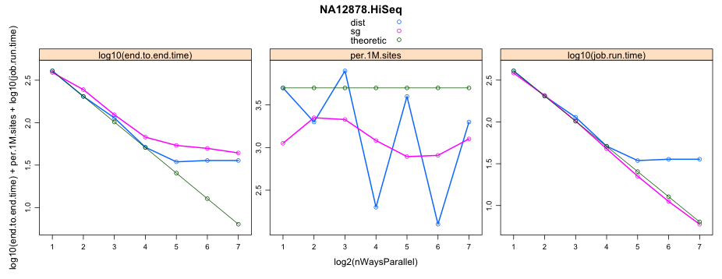
Scatter-gather vs. distributed parallelism: HiSeq
But still the distributed version finished first!
Some distributed jobs are trapped in the queue

